Slide 1
Vulnerability Pathway

Slide 2
Background

Slide 3
Safeguarding Adult Reviews (SAR)
Safeguarding Adult Boards have a duty to conduct a SAR where:
An adult with care and support needs has died, or experienced serious abuse or neglect, and
The Board knows or suspects that the death resulted from abuse or neglect, and
There is reasonable cause for concern about how the Board, its members or others worked together to safeguard the adult
The Board has discretion to conduct a SAR in any other circumstance regarding an adult with care and support needs
The purpose is to identify lessons, apply learning to future work and improve how agencies work (singly and together) to safeguard adults
Notes:
Moira Wilson

Slide 4
SAR National Learning
Second National Analysis of Safeguarding Adult Reviews (SARs)
SARs completed between April 2019 and March 2023
National library
Requests to all 136 SABs (100% response)
Screening information taken from 652 SARs
Notes:
Moira Wilson

Slide 5
SAR National Learning - Findings
Mental health (72%), chronic physical health (63%), substance misuse (46%), impaired mobility (27%) all increased compared to the first national review
47% lived alone, 30% in a group setting, 10% street homeless
9% had experience of care as a child or young person
The most common cause of harm was ‘self’ (76%); 28% were care providers and 28% were other professionals
60% of cases involved self-neglect
16% of cases involved domestic abuse
Notes:
Moira Wilson

Slide 6
Learning: Shortcomings & Key Themes
Professional culture and negative attitudes: risky/distressed behaviour viewed as ‘lifestyle choice’, attention-seeking, non-compliance/engagement. Resignation & low expectation of change
Safeguarding that was not personalised; adults with communication needs, learning disabilities, neurodiversity and mental health needs left out of decisions/discussions about their support
Failure to recognise the significance of repeated patterns of engagement followed by disengagement. Some agencies lacked flexibility in their expectations/approach for engagement
Transition for young people to adult services lacked coordinated assessment and planning, leading to a reduction in support
Notes:
Moira Wilson

Slide 7
SAR Samantha Published 2023
Samantha was a 33-year-old female who had a longstanding mental health illness, diagnosed with paranoid schizophrenia, who was found deceased, further to Covid symptoms.
It was noted that Samantha had been deceased for several days before she was found.
Samantha lived alone in a private rented property, poorly maintained by the landlord, and in a neglected state.
Services noted that Samantha was dishevelled and struggled to care for herself in the previous months.
In the months before her death, Samantha regularly called 999 to report noises in her home that she believed were intruders.
Notes:
Moira Wilson

Slide 8
SAR Samantha Recommendations
Multi-Agency Frameworks and Processes
RSAB must escalate and expedite VARMM guidance that includes:
Threshold criteria for referral.
The right designation/organisation for the Chair or to rotate Chairing
Escalation process
How safeguarding processes under the Care Act sit within the VARMM process map. e.g., Does VARMM stop when Section 42 starts and/or vice versa?
Where CMARAC fits in
Is there a step-up and step-down process from other processes?
Commitment of agencies to attend VAP at the right level
Assurance gathering on the efficacy of the system
Notes:
Moira Wilson

Slide 9
2023
The C-MARAC and VARM processes were historically managed by SYP.
The model has undergone several iterations over the years.
In 2023, the process was suspended to enable a full review of the model to ensure it was fit for purpose and to seek the full support of the Rotherham Safeguarding Adults Board and Safer Rotherham Partnership
The review looked at the Vulnerability Pathway in full considering the Community Multi-Agency Risk Assessment Conference (C-MARAC), Vulnerable Adults Risk Management Meeting (VARMM), and the Vulnerable Adults Panel (VAP)
Notes:
Moira Wilson

Slide 10
Development Sessions
Partnership events followed the announcement…
The final session took place in Feb 2025.
All partners contributed to the events.
We looked at -
What’s working well
What are we worried about
What do we need to do differently
We have -
Revised the pathway (slightly)
Combined the VAP with the Pre-SAR process
Simplified the referral paperwork and process
Developed a feedback loop to the referrer
Notes:
Andrew Wells

Slide 11
Professional Challenges
Complex issues such as safeguarding, exploitation, mental health, drug and alcohol use, alongside individuals leading complex and chaotic lifestyles, have long been a contributory factor to many partners in Rotherham
Each partner agency uses substantial resources to support complex cases, prolific offenders, and people surrounded by chaos
Notes:
Andrew Wells

Slide 12
Professional Challenges
Frustration and anxiety
Organisational context
Not knowing what to do, what works, where to go?
Thresholds for intervention
Uncertainty about legal frameworks
Understanding underlying causes
Notes:
Andrew Wells

Slide 13
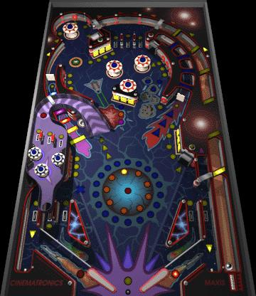
System Pinball
“Lifestyle choices”
Fragmented care
Survivor communication
People viewed as problems
Punitive interventions
Coercive practice
Unintentional re-traumatisation
Notes:
Robyn Leach

Slide 14
The New Vulnerable Adults Pathway

Slide 15
Partnership Working
Aims:
Space to reflect and challenge the narratives around complex people
Share and manage risk through trauma-informed practice
Tolerate uncertainty
Better understand root causes
Create bespoke, person-centred plans
Balance the need for practical support and immediate safety planning, alongside longer-term therapeutic interventions
Be person-led, not system-led
“Hold complexity in a compassionate way”
Notes:
Robyn Leach

Slide 16
Vulnerability Pathway.
Partnership Triage Meeting
Community Multi-Agency Risk Assessment Conference
Vulnerable Adult Risk Management Model
Vulnerable Adult Panel
Notes:
Robyn Leach

Slide 17
Criteria
The Vulnerability Pathway supports adults who…
Are experiencing ongoing or repeated victimisation.
Are subject to or involved in anti-social behaviour and/or crime.
Are believed to be making unwise decisions.
Are at high-risk of harm, or their behaviour poses a risk to or affects others.
Have complex needs.
Are experiencing episodes of severe and repeated self-neglect.
In the following context…
Repeated or escalating incidences in frequency and/or severity.
The impact of the adult’s behaviour is high and spans across multiple organisations.
Notes:
Robyn Leach

Slide 18
Partnership Triage
The purpose of the Partnership Triage Meeting is to review referrals into the Vulnerable Adults Pathway, share information, consider risk and reach a multi-agency decision regarding the progression of cases into the pathway.
Members:
South Yorkshire Police (SYP)
Rotherham, Doncaster, and South Humber Foundation Trust (RDASH)
Rotherham Council Adult Care and Integration (RMBC)
Rotherham Council Housing (RMBC)
Notes:
Neil Windle

Slide 19
C-MARAC
The purpose of C-MARAC is to take a multi-agency approach to address the complex needs of identified vulnerable adults where isolated interventions from organisations and MDTs have not reduced risk to an acceptable level.
The meeting provides a multi-agency response to escalating risk and/or specialist intervention.
The C-MARAC Coordinator is the SYP Safer Neighbourhood Vulnerability Sergeant – Neil Windle.
The referring organisation will be allocated a 20-minute slot to attend C-MARAC to present information about the case.
Actions, leads and timeframes agreed in the meeting will be documented in an Action Plan and shared with all attendees.
Notes:
Neil Windle

Slide 20
Vulnerable Adult Risk Management (VARM)
The purpose of the VARMM is to share information, identify solutions to reduce risk and co-ordinate activity across organisations, to address the needs of identified vulnerable adults.
It also aims to support the lead organisation to hold the case safely, by offering peer support, sharing ideas, actions and problem solving.
The VARMM Coordinator is the RMBC Vulnerable Adults Professional Lead – Robyn Leach.
Notes:
Robyn Leach

Slide 21
Vulnerable Adult Risk Management (VARMM)
Escalation to VARMM occurs when…
Level of complexity and/or risk requires more in depth problem-solving.
The vulnerable adult is at risk of serious harm or death.
C-MARAC involvement and/or previous interventions have not met the desired outcomes.
Notes:
Robyn Leach

Slide 22
Risk Responsibility
The responsibility to take appropriate action rests with individual agencies; it is NOT transferred to the VARMM or Chair. The role of the VARMM is to facilitate, monitor and evaluate effective information sharing and support planning for vulnerable adults at risk of serious harm or death.
Notes:
Robyn Leach

Slide 23
Vulnerable Adult Panel (VAP)
The Vulnerable Adult Panel provides strategic oversight of the Vulnerability Pathway including the C-MARAC and VARMM platforms, as well as those subject to statutory Section 42 Enquiries.
Referral to the VAP can occur when…
Commissioning or resource decisions are needed.
There are unresolved system-wide issues blocking progress to mitigate risk.
There is an unresolved dispute between organisations, relating to a specific vulnerable adult.
Approval to exit VARMM or Safeguarding is jointly recommended by all members, in instances when all agency support has been fully explored and implemented, but the level of risk remains.
Notes:
Robyn Leach

Slide 24
Referrals
A referral into the Vulnerability Pathway is initiated by the organisation that identifies that current attempts to support a vulnerable adult are not working.
Only cases that are referred using the official Vulnerability Pathway Referral Form will be considered.
Fully completed referrals are to be submitted to: vulnerability.referrals@rotherham.gov.uk
Notes:
Robyn Leach

Slide 25
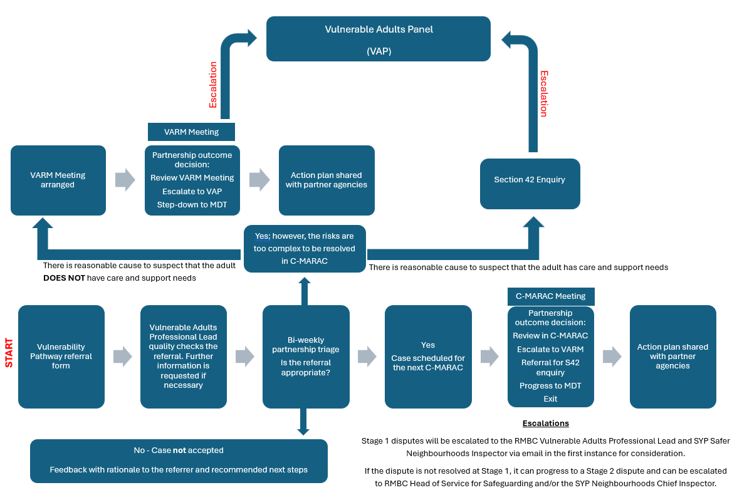
Vulnerability Pathway
Notes:
Robyn Leach

Slide 26
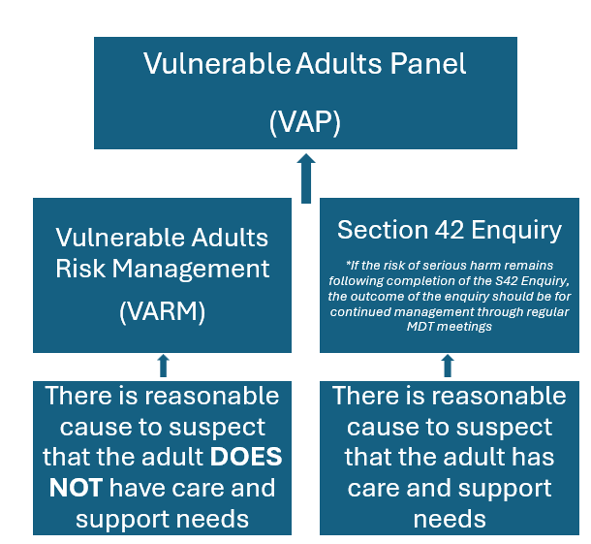
VARM & Section 42
There will be instances when an adult has eligible care and support needs and presents with additional complexities, such as – substance use, mental health, historical or current exploitation. This will be considered on a case-by-case basis and a partnership decision will be made regarding whether it is more appropriate to manage the case under VARMM.
Complex, high-risk cases are not to be managed by 2 process, it is either Safeguarding Adults or the Vulnerability Pathway.
Notes:
Robyn Leach

Slide 27
Case Example - David
Referred to Complex Lives in 2022
Physical assaults
Exploitation & cuckooing
Alcohol use & recovery
VARM meetings
Multi-agency approach & joint visits
Practical support
Sense of safety
Mum – “he looks like my lad again”
Closed to services in 2023
No re-referrals
Notes:
Robyn Leach

Slide 28
Operation Stovewood

Slide 29
Operation Stovewood.
We have developed ‘excellent’ working relationships with colleagues from the NCA and alongside other partners developed a bespoke MDT process for victims and survivors.
The MDT process has been led by the Trauma and Resilience Service and consists of;
The Trauma and Resilience Service
Independent Sexual Violence Advocates
Domestic Abuse Workers (Hopian/DAAOS)
Complex Lives Team
Vulnerable Adults Professional Lead
And any other agencies who may be working with the survivor, so With You, RDASH, GROW, housing etc.
The MDTs have always been person-centred and solution focused.
Notes:
Andrew Wells

Slide 30
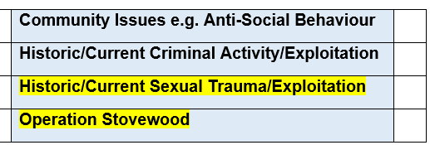
Supporting Survivors Moving Forward
The Vulnerability Pathway will incorporate the transition arrangements for Operation Stovewood from the National Crime Agency into South Yorkshire Police, and the transition of the Trauma and Resilience Service from a Rotherham specific service to a wider South Yorkshire service.
For referrals into the Vulnerability Pathway which indicate ‘Historical/Current sexual Trauma/Exploitation’ or ‘Operation Stovewood’, TRS and the ISVA service will be invited to the subsequent meetings to offer consultation and support to the victim and partner agencies.
The aim is the continue the brilliant work of the MDT process which has been supporting victims and survivors under the National Crime Agency.
Notes:
Andrew Wells

Slide 31
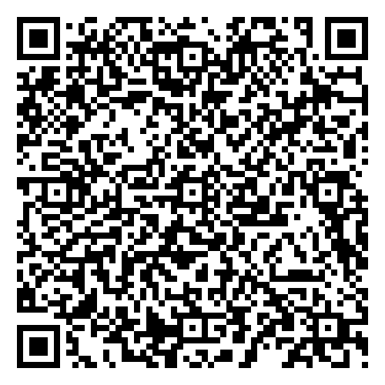
Questions
Notes:
Andrew Wells

Slide 32
Resources
Rotherham Safeguarding Adults Board Website
Vulnerable Adults Pathway – Rotherham Safeguarding Adults Board
Notes:
Jackie Scantlebury

Slide 33
Thank you

